Slide 1
Data Science Task
Saaqib Mahmood

Slide 2
Contents
Aims and Objectives
Initial Fitness Indicators
Analysis of Fitness Progress
Users with no Progress?
User Recommendations

Slide 3
Aims and Objectives
Identify runners who have made progress in their fitness journey
- Analyse given metrics
Identify runners who have not been as successful
- What makes them less successful?
Provide recommendations to improve

Slide 4
Basic Fitness Indicators
Fitness has a direct correlation to:
Heart rate
Speed
Runtime
General trends involve an increase or decrease in certain factors

Slide 5
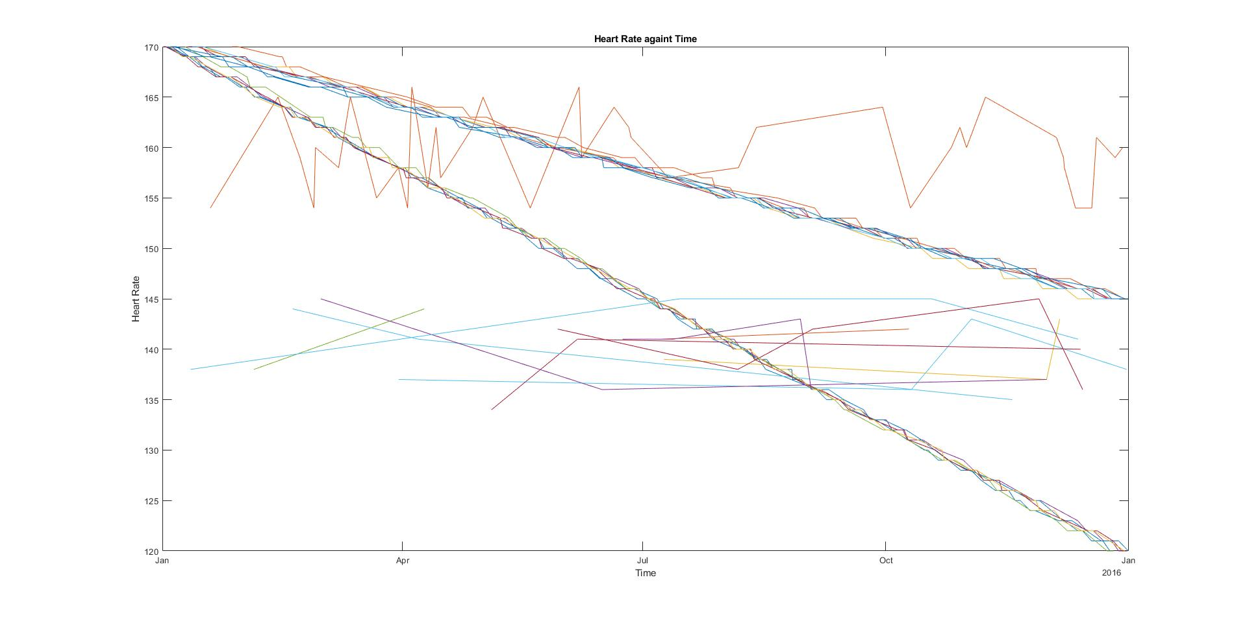
Initial Analysis
General downwards trend in heart rate – suggesting health improvements
However, some users’ heart rate do not have a set pattern.
Figure 1: Heart rate against time

Slide 6
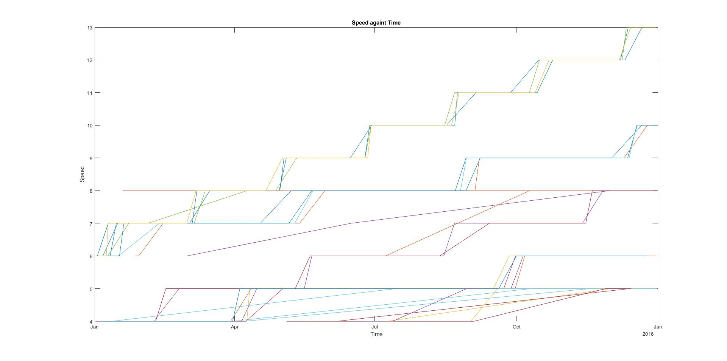
Initial Analysis
General upwards trend in speed
Suggests users get faster as time goes on
Figure 2: Speed of runs against time

Slide 7
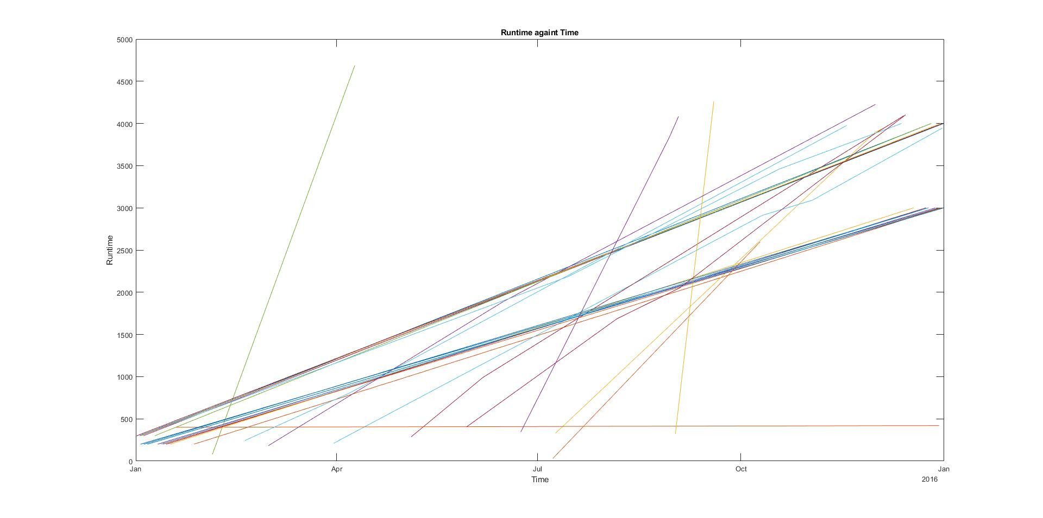
Initial Analysis
General upwards trend in time for runs
Suggests users are able to run for longer
Figure 3: Time taken for runs against time

Slide 8
No Progress?
There are some that seems to not make too much progress
But why?
Training plan? Or maybe interactions?

Slide 9
Training Plan
Can we look deeper into those with less fitness progress?
User ID | Training Plan
De2t1w4lJxaihbZJyXMy – 339 | 3
qSBwavqAcTutVvt7JDYs -234 | 2
od1apuIakbeE0GgQnDw4 – 240 | 3
tIaMUUHRiwxtQi8kDhVH – 500 | 1
gkXfBi4HGgqsFwDeReWK – 142 | 2
vhvgjZWd3metJr0iSaqJ - 1136 | 2
jt6R7PqDvzugIPQQJAJb - 236 | 2
z93xvl7rItlLqUybXwUa – 754 | 2
Training Plan | Percentage of users with little fitness progress
1 | 42%
2 | 78%
3 | 100%
19 | 0%
Table 2: Percentage of users with little fitness progress in each training plan
Table 1: Sample of users with little fitness progress and their training plans

Slide 10
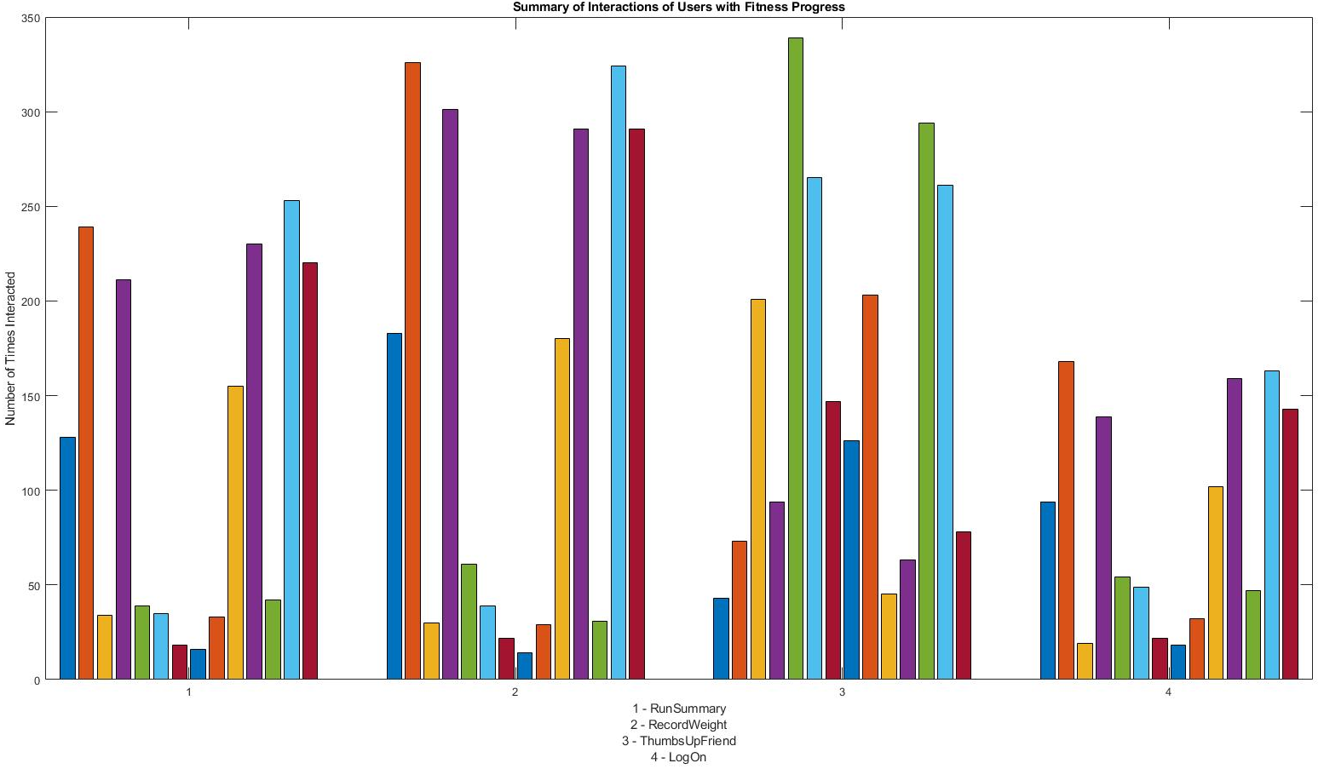
Interactions
Is there a correlation between interaction and levels of fitness?
Motivation to work?
Figure 4: Summary of app interactions with users with fitness progress

Slide 11
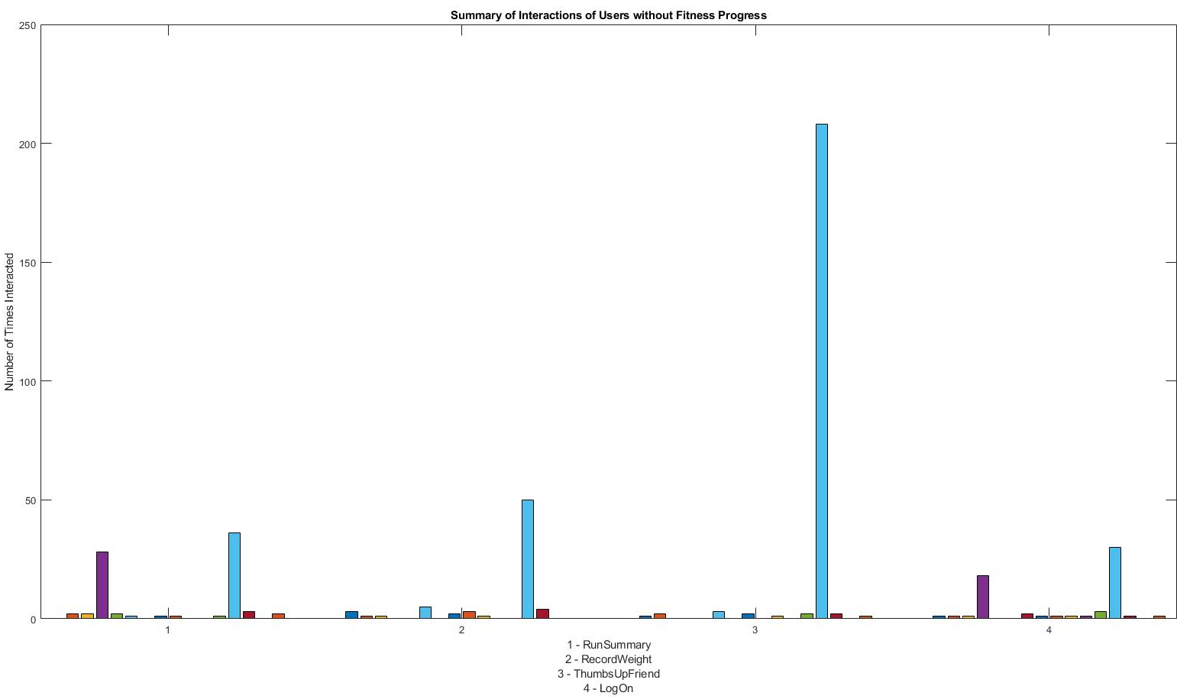
Interactions
What about those that do not have much progress in their fitness?
Figure 5: Summary of app interactions with users with little fitness progress

Slide 12
Next Steps Recommendations
User with fitness plans 2 and 3 seem to make little progress with fitness
-> Trying out Plan 1or 19 may help
People with more interactions with the app tend to improve fitness
-> Interact more with app
-> Could help in motivational purposes and observing accomplishments
-> Tracking helps see progress towards goal

